Slide 1
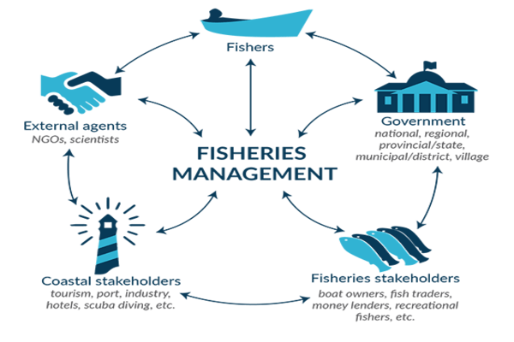
ONLINE HATCHERY ACCREDITATION SYSTEM
Project by students of vivekananda college, thakurpukur

Slide 2
UNIVERSITY OF CALCUTTA PROJECT ON Online Hatchery Accreditation System
Submitted by:
Rakesh Das
Saleha Manzari
Anupama Halder
Dhrubashis Basak
Swapnaneel Sengupta
Under the guidance of:
Prof. Amitava Biswas
Dept. of Computer Science
Vivekananda College, Thakurpukur

Slide 3
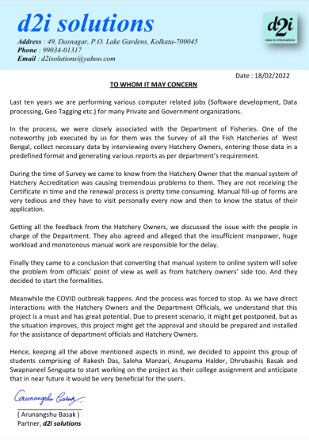
ORDER LETTER
We received the following order letter from ‘d2i solutions’ who appointed us for completing this project.
This is a live project for the Department of Fisheries, West Bengal which is planned to be implemented in the near future.

Slide 4



INTRODUCTION
What is Hatchery ?
Hatchery is a facility where eggs are hatched under artificial conditions, especially those of fish, poultry or even turtles. In this project we are concerned with fish eggs.
What is Hatchery Accreditation ?
Accreditation is the process of Registration of the Hatchery by The Government of India, Department of Fisheries. It should be renewed yearly against a Registration Fees.
Why Hatchery Accreditation?
In order to ensure that these hatcheries produce quality fish seeds as well as healthy grown-up fish, the process of accreditation of hatcheries is required.
4

Slide 5

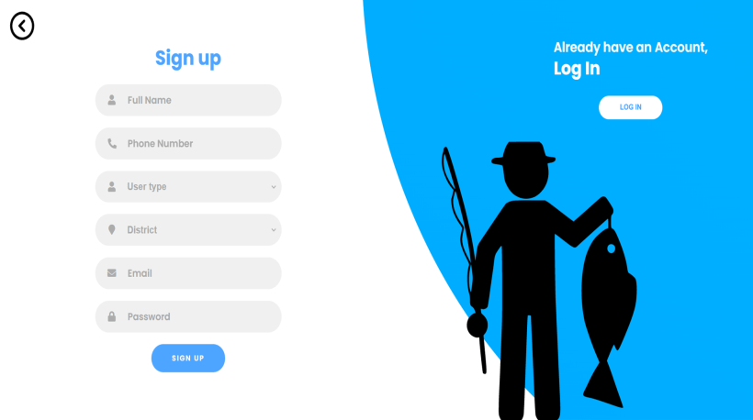
DOMAIN DESCRIPTION
Project Purpose -
Migration of a currently offline hatchery accreditation process to a fully online one.
Online Modules -
Form Application
Form Renewal
Status Update
Certification
Messaging
Employee Authorization
Notice Board
Form Verification
Search Hatchery
Pending Renewal List
5

Slide 6
BENIFITS OF THE PROJECT
Convenience: In this COVID situation the Hatchery Owner can initiate the Registration Process from the comfort of his home, without stepping outside.
Faster and Accurate Verification: Online Verifications are much faster and accurate than offline documents checking.
E-Certificate: Printing the Certificate manually and the tedious process of handing over the Certificate to the Hatchery Owners are totally eliminated.
Online Status Update: Status Checking will be very helpful to the Hatchery Owner as they do not need to visit their respective branch offices to get updates about their accreditation.
Instant Messaging: This will help the Hatchery Owners for some prompt suggestion, assistance or complain to and from the Government officials.

Slide 7
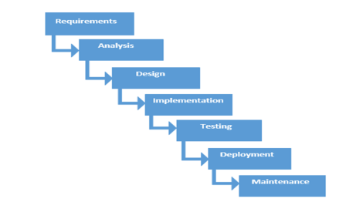
METHODOLOGY

Slide 8
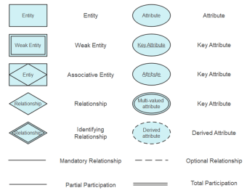
ER-DIAGRAM
An Entity–relationship model (ER model) describes the structure of a database with the help of a diagram, which is known as Entity Relationship Diagram (ER Diagram). An ER model is a design or blueprint of a database that can later be implemented as a database. The main components of E-R model are entity set and relationship set.
An ER diagram shows the relationship among entity sets. An entity set is a group of similar entities and these entities can have attributes. In terms of DBMS, an entity is a table or attribute of a table in database, so by showing relationship among tables and their attributes, ER diagram shows the complete logical structure of a database.

Slide 9
ENTITIES AND ATTRIBUTES
Entities | Attributes
User_tb | ID , Name, Type, Password, Email, District, Certificate Id, Astatus, Status
Feedback_tb | Slno ,name ,description
Login_tb | Slno ,ID ,log_time , log_date
Certify_tb | CetificateId, Name
Application_tb | ID ,Acc No, Hatchery Name , Email, Phone Number, Owner Address, Hatchery Address, Pool, Pond, Energy Source, Water Source, Procured Quantity, Species Procured, Total Production, species Produced, Water Quality, Diseases Description
Pay_tb | TransactionId, ID, Transaction Date, Amount, Card No, Bank
Sts_tb | ID ,Acc No, Acc Date, Acc Valid, Acc level 1 emp name, level 1 date, Acc level 2 emp name, level 2 date, Acc level 3 emp name, level 3 date, Current status.
Msg_tb | Slno ,SenderID, Content, Receiver ID.
MIS_tb | Slno , Report name.
Notice_tb | Slno, Date, Description
Admin_tb | ID , Name, Email,Password
*Red is Primary Key, *Purple is Foreign Key

Slide 10
Admin manages Hatchery Accreditation system
User is a Employee
User is a Hatchery owner
Hatchery owner submits/renew form of accreditation.
Hatchery owner view notice board.
Hatchery owner message messages.
Hatchery owner downloads certificate.
Hatchery owner gives feedback.
Hatchery owner pays accreditation fees.
Form requires accreditation fees.
Employee is a Level 1 Officer
Employee is a Level 2 Officer
Employee is a Level 3 Officer
Employee generates MIS Reports.
Employee generates Emergency alert
Level 3 Officer renew certificate
Level 3 Officer issue certificate
Level 3 Officer authorize Level 2 Officer
Level 2 Officer authorize Level 1 Officer
Employee message messages
Employee can verify forms
RELATIONSHIPS

Slide 11
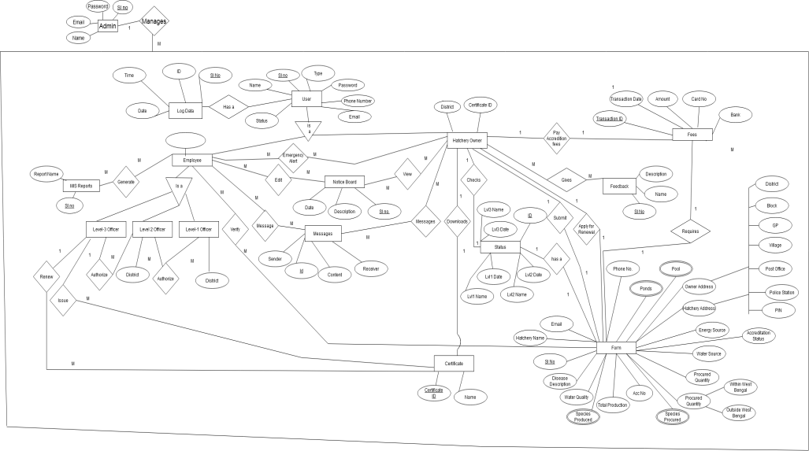
ER Model
ER-DIAGRAM
astatus

Slide 12
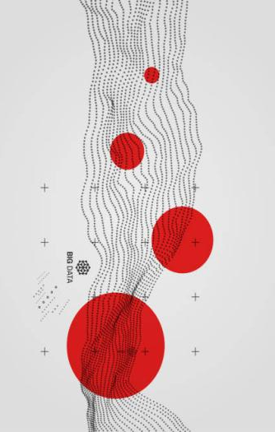
DATA-FLOW DIAGRAM
A data flow diagram (DFD) is a graphic tool used to describe and analyze the movement of data through a system - manual or automated – including the processes, stores of data, and delays in the system. Data flow diagrams are the central tools and the basis from which other components are developed. The transformation of data from input to output, through processes, may be described logically and independently of the physical components associated with the system.
The Data-Flow Diagrams of our project are as follows.

Slide 13
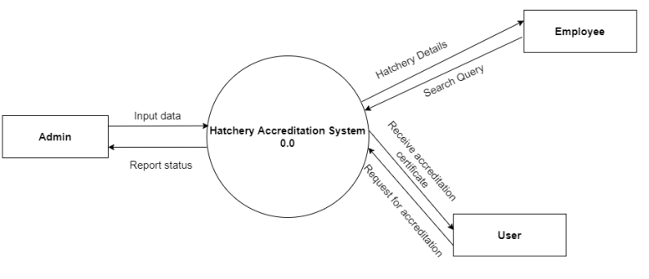
CONTEXT LEVEL DFD
DATA-FLOW
DIAGRAM

Slide 14
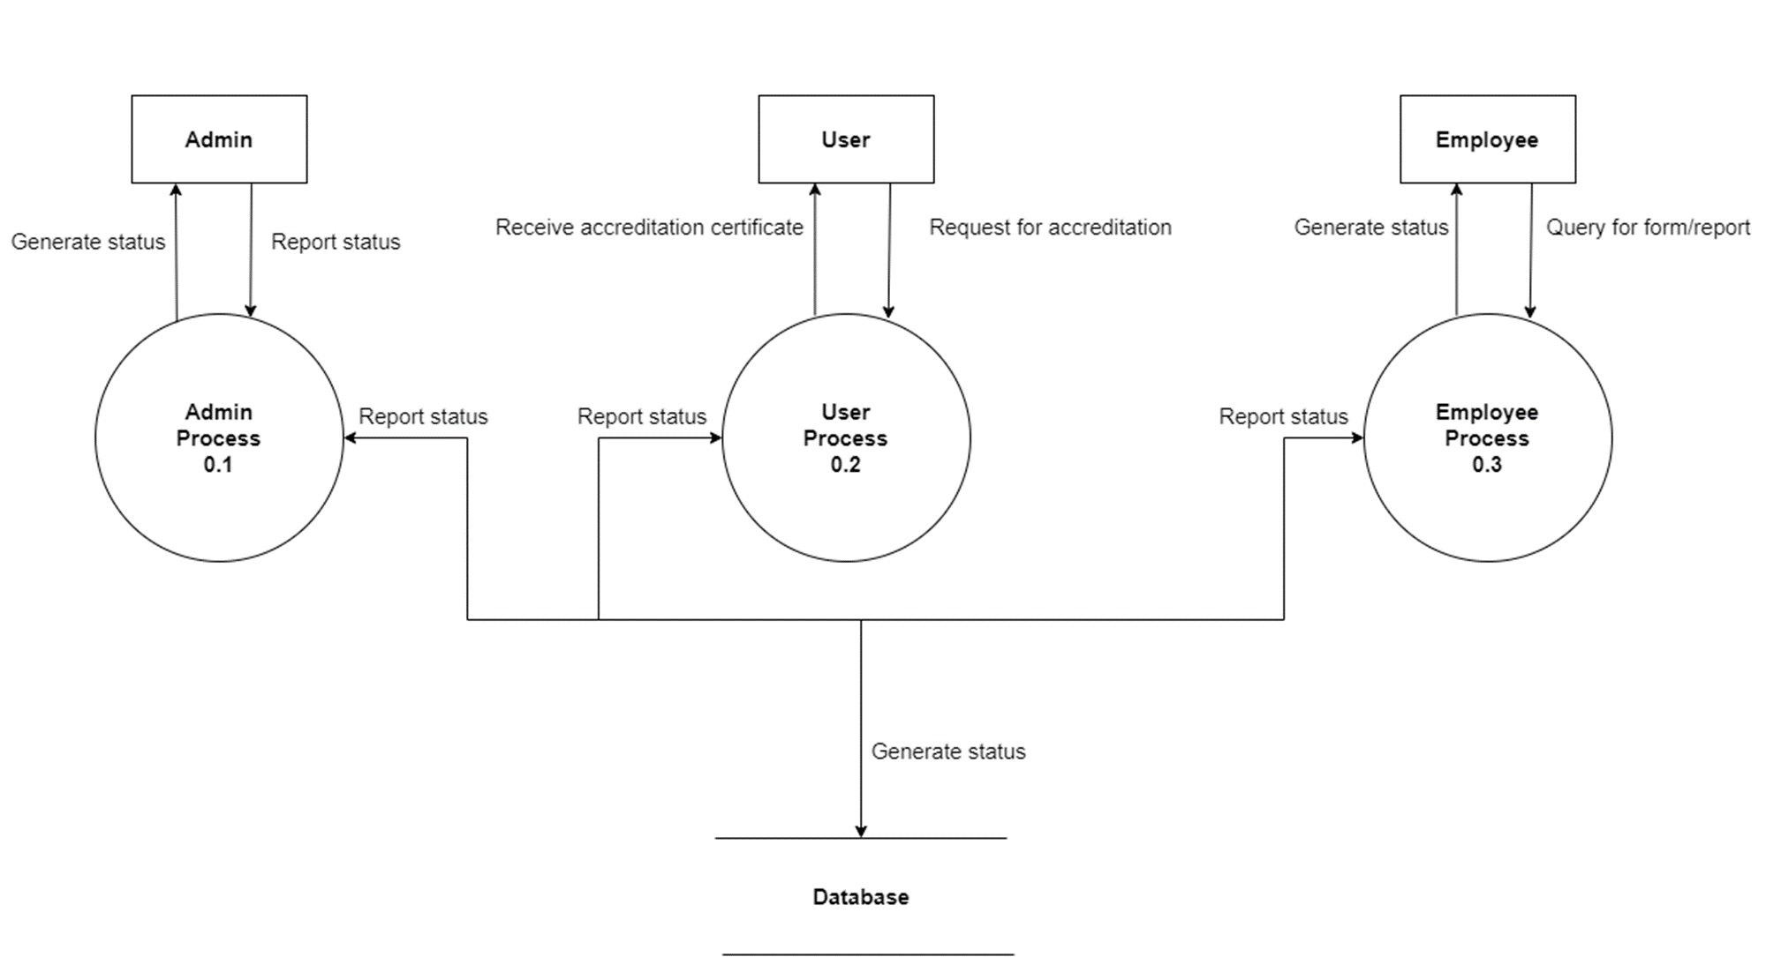
LEVEL-0 DFD
DATA-FLOW
DIAGRAM

Slide 15
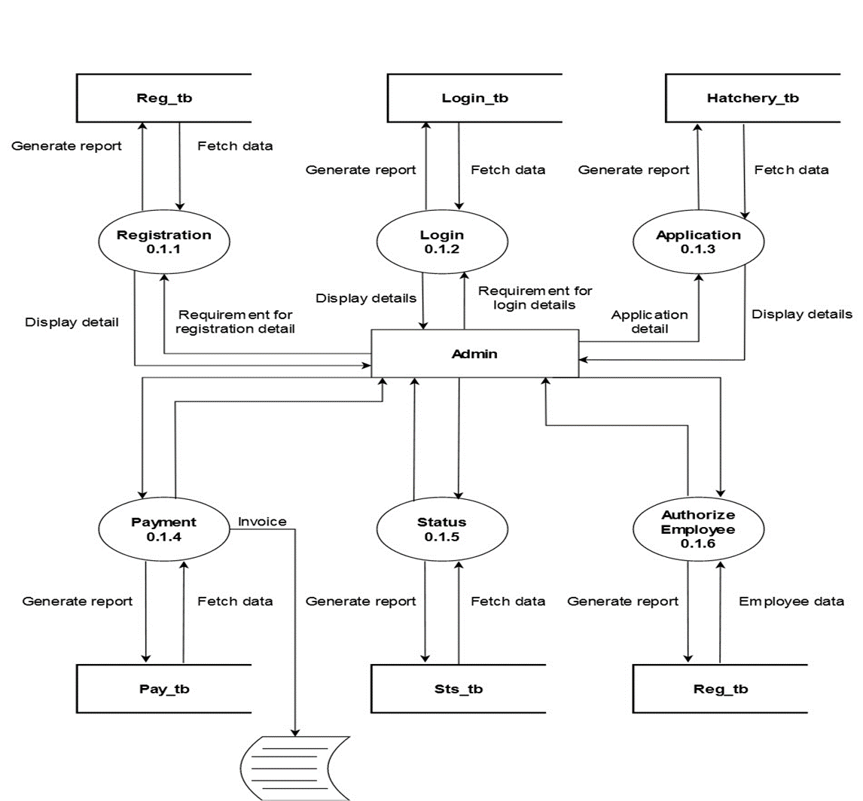
LEVEL-1 DFD for ADMIN
DATA-FLOW
DIAGRAM

Slide 16
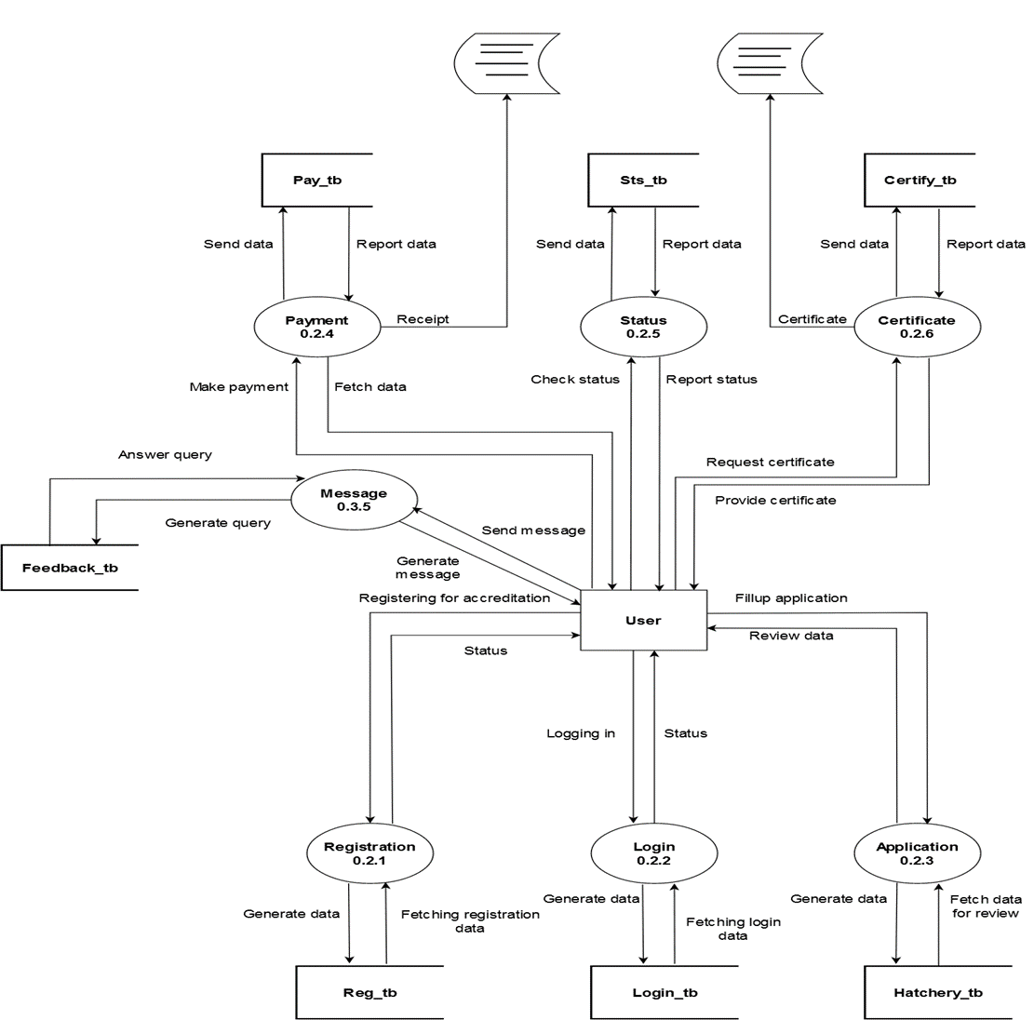
LEVEL-1 DFD for USER
DATA-FLOW
DIAGRAM

Slide 17
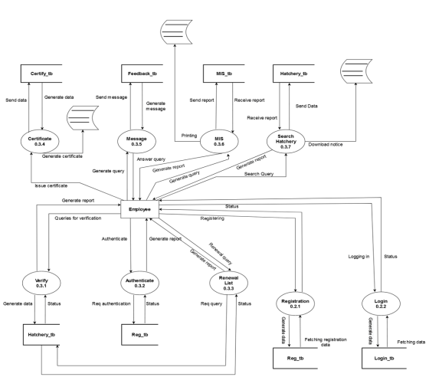
LEVEL-1 DFD for EMPLOYEE
DATA-FLOW
DIAGRAM

Slide 18
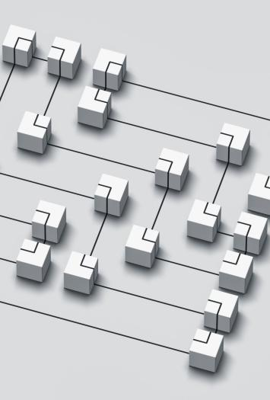
FUNCTIONAL FLOWCHART
A system consists of many different activities or processes. We know the relation between the processes that process will contain several individual processes. We often show these relations in terms of process charts.
The Functional Flowcharts of our project is as follows.

Slide 19
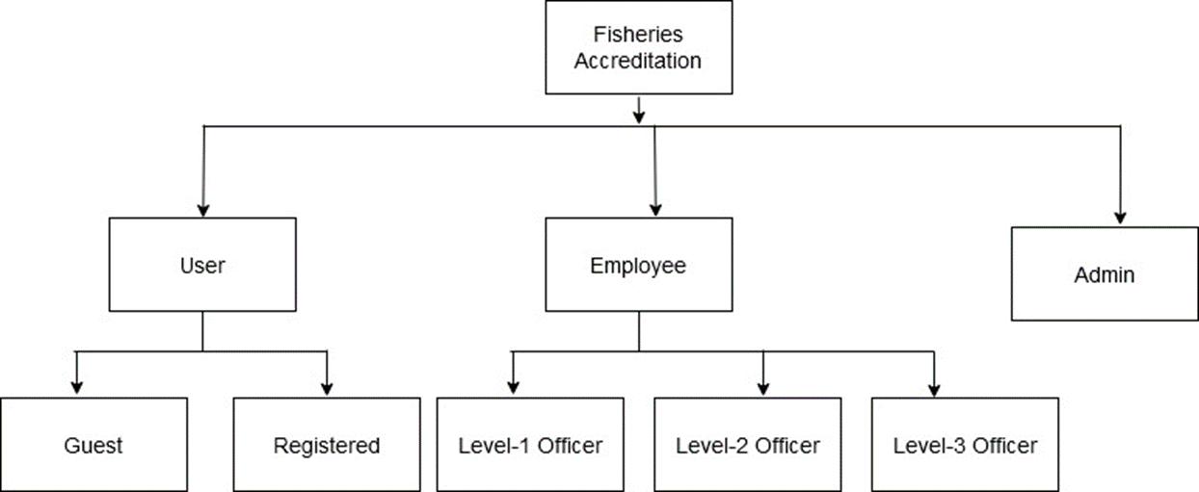
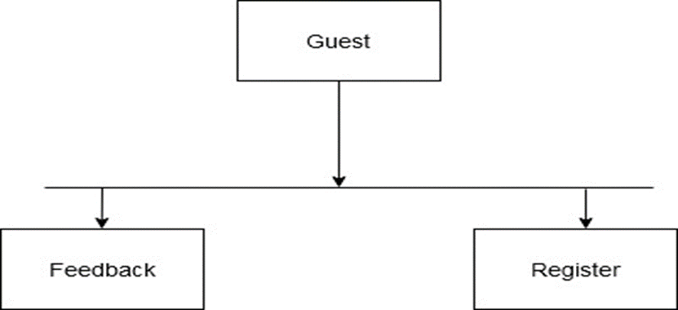
FUNCTIONAL FLOWCHART

Slide 20
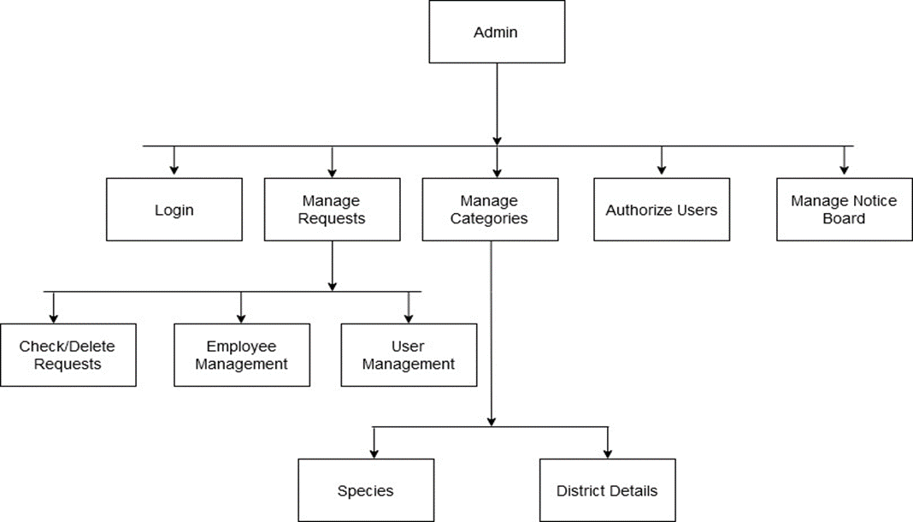
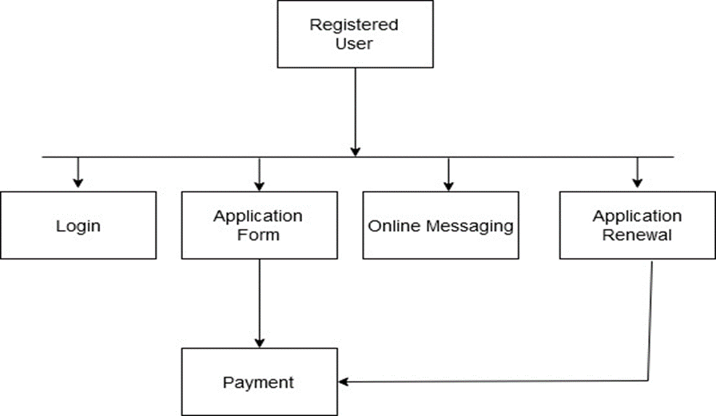
FUNCTIONAL FLOWCHART

Slide 21
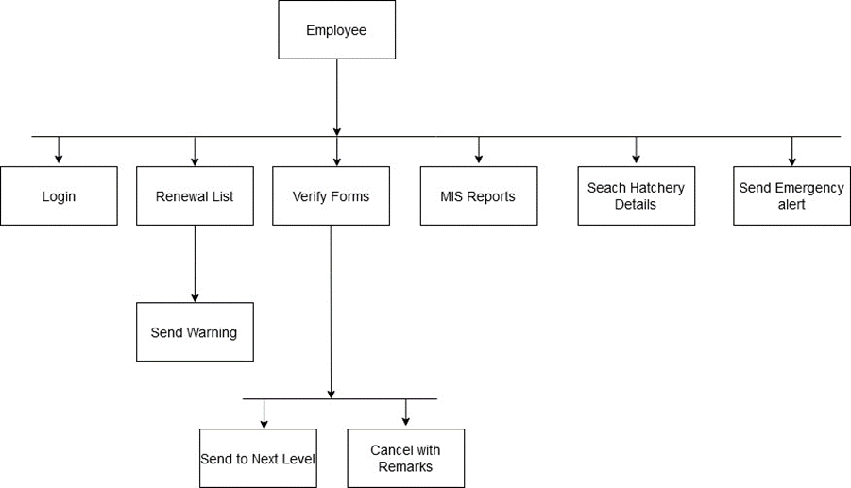
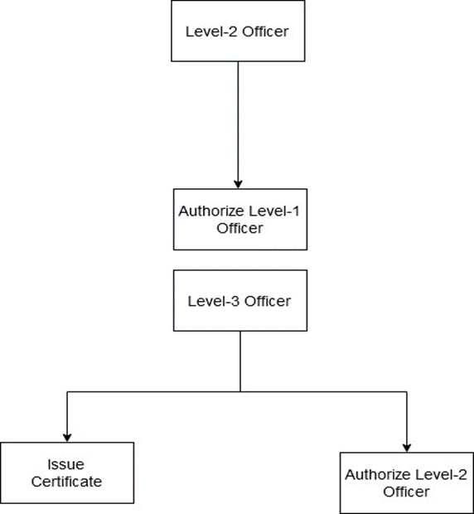
FUNCTIONAL FLOWCHART

Slide 22

USE-CASE DIAGRAM
An use case diagram is a graphical depiction of a user's possible interactions with a system. An use case diagram shows various use cases and different types of users the system has and will often be accompanied by other types of diagrams as well.
The Use-Case Diagrams of our project are as follows.

Slide 23
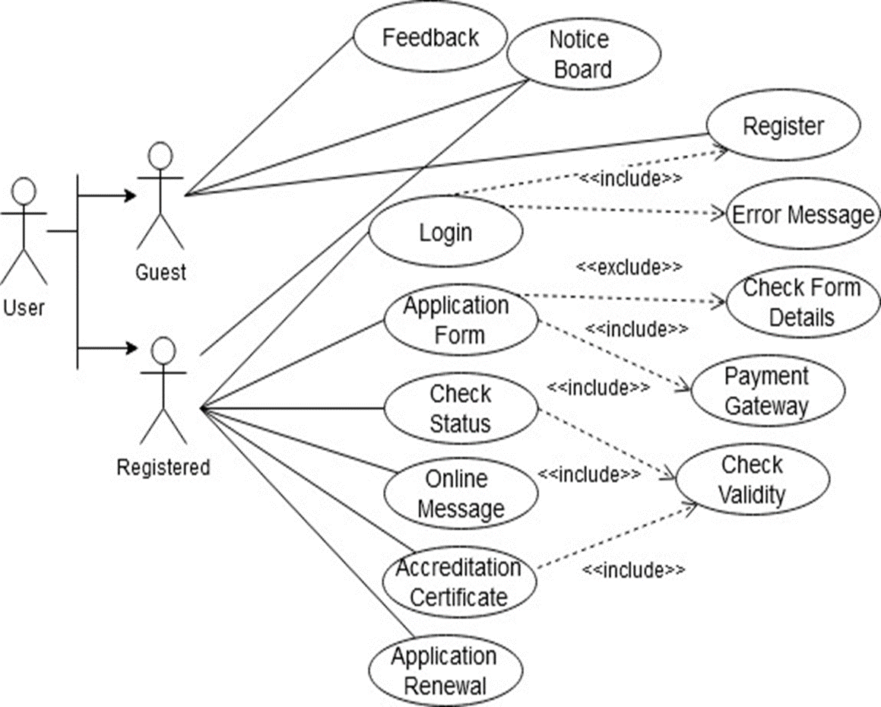
USE-CASE FOR USER
USE-CASE
DIAGRAM

Slide 24
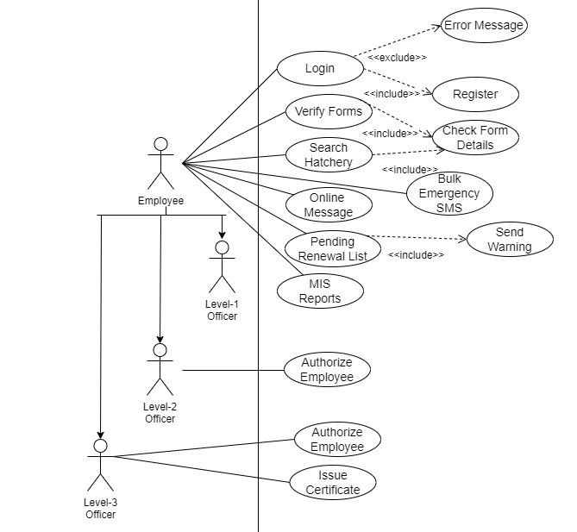
USE-CASE FOR EMPLOYEE
USE-CASE
DIAGRAM

Slide 25
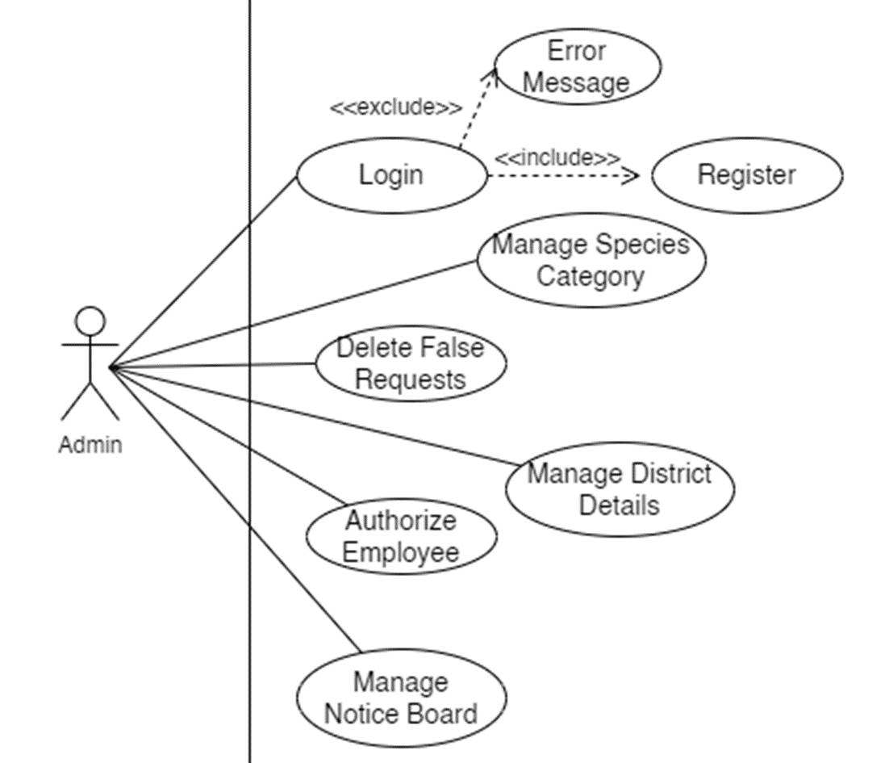
USE-CASE FOR ADMIN
USE-CASE
DIAGRAM

Slide 26

ACTIVITY DIAGRAM
Activity diagram is basically a flowchart to represent the flow from one activity to another activity. The activity can be described as an operation of the system. The control flow is drawn from one operation to another. This flow can be sequential, branched, or concurrent. Activity diagrams deal with all type of flow control by using different elements such as fork, join, etc.
The Activity Diagrams of our project are as follows.

Slide 27
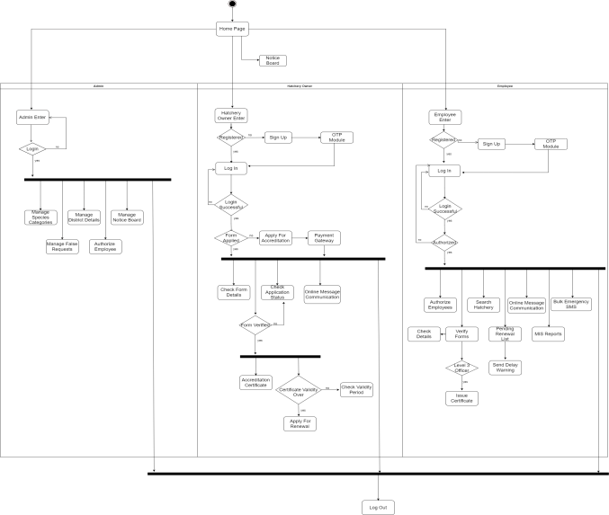
ACTIVITY
DIAGRAM

Slide 28
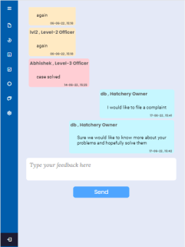
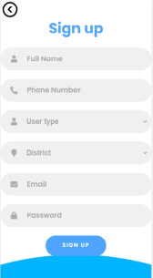
SCREENSHOTS

Slide 29
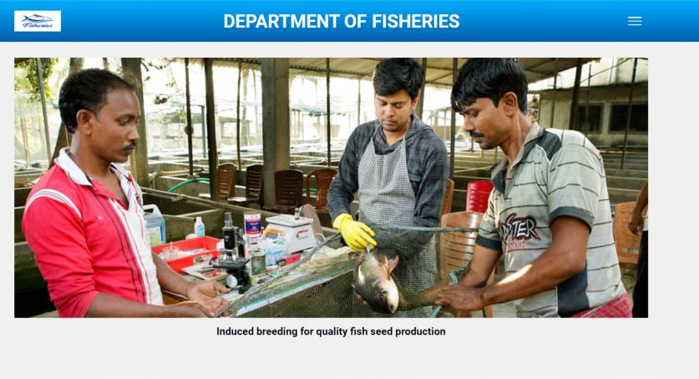
Home Page

Slide 30
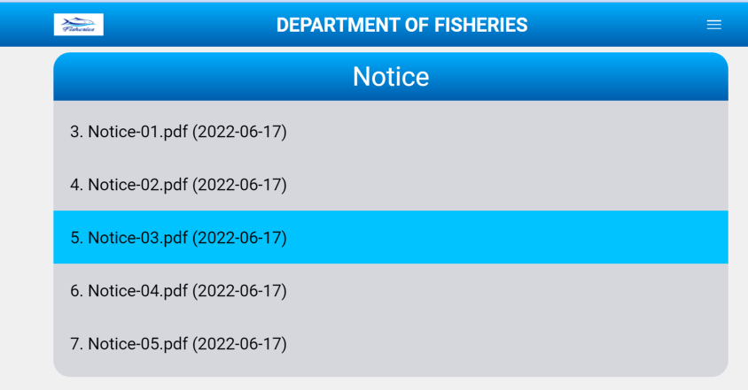
Home Page Notice Board

Slide 31
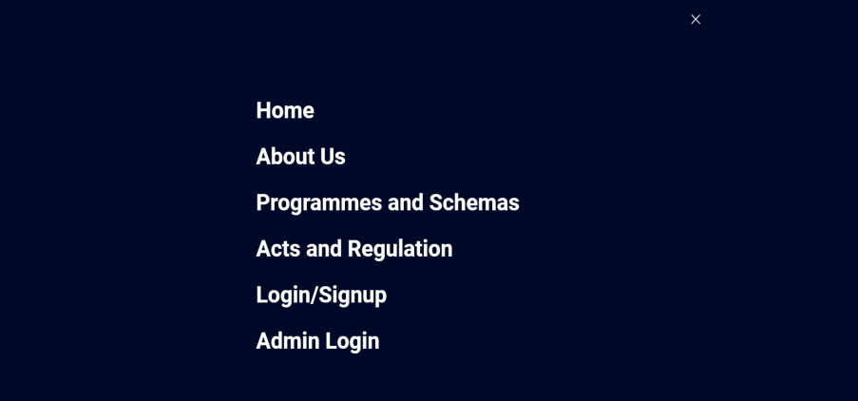
Home Page Menu

Slide 32
Sign Up

Slide 33
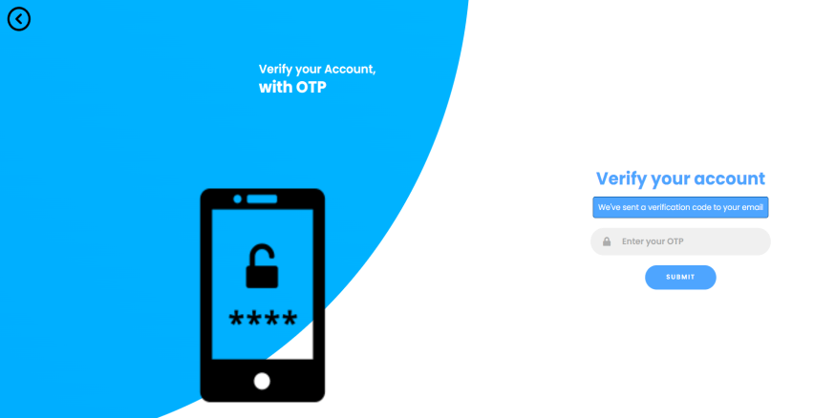
OTP Verification

Slide 34
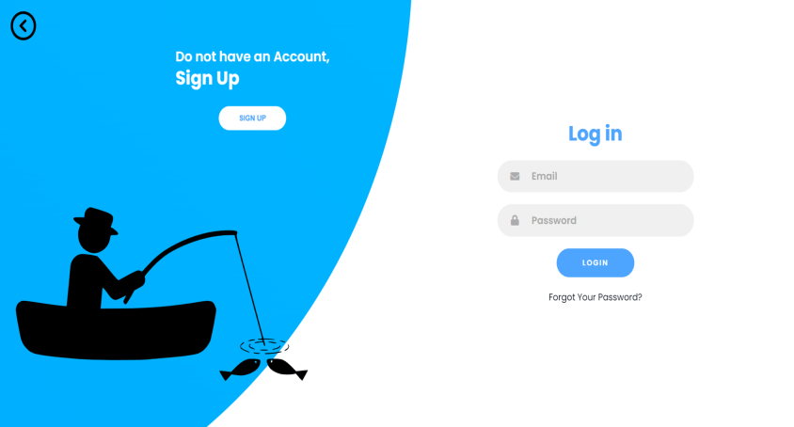
Log In

Slide 35
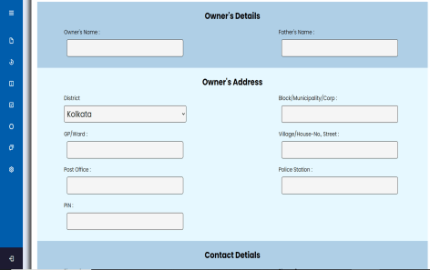
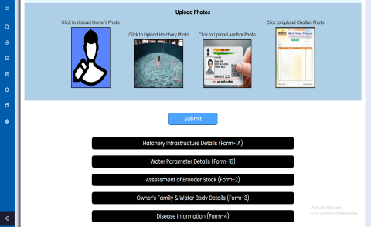
User Application Form

Slide 36
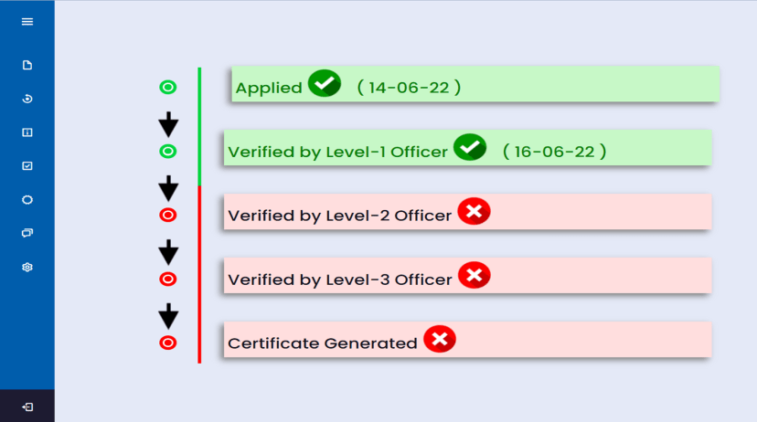
User Form Status

Slide 37
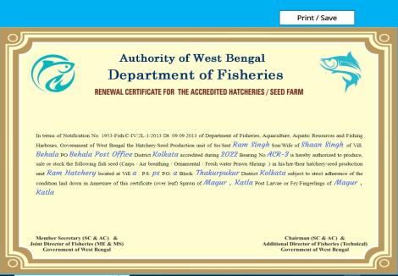
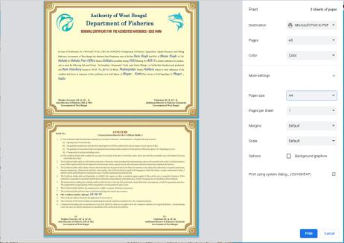
Certificate Print

Slide 38
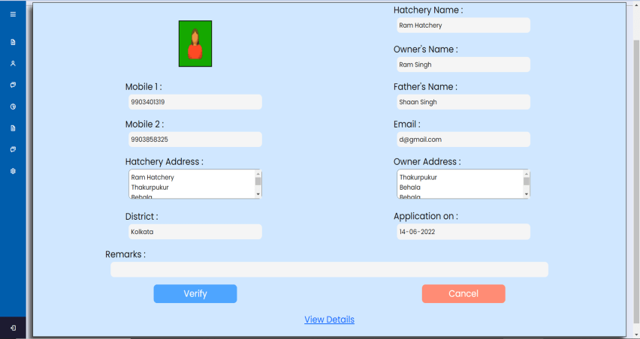
Form Verification

Slide 39
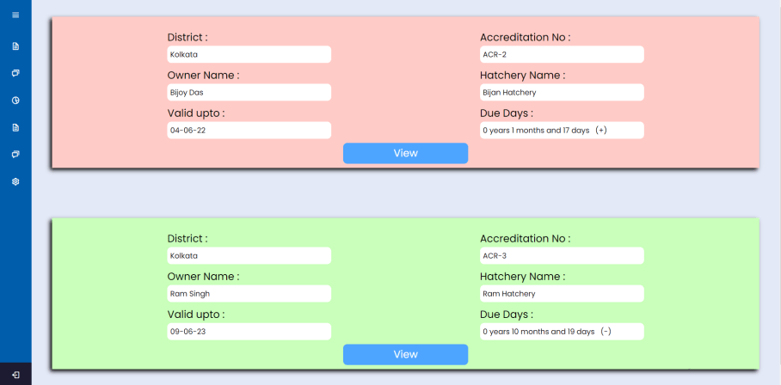
Pending Renewal List

Slide 40
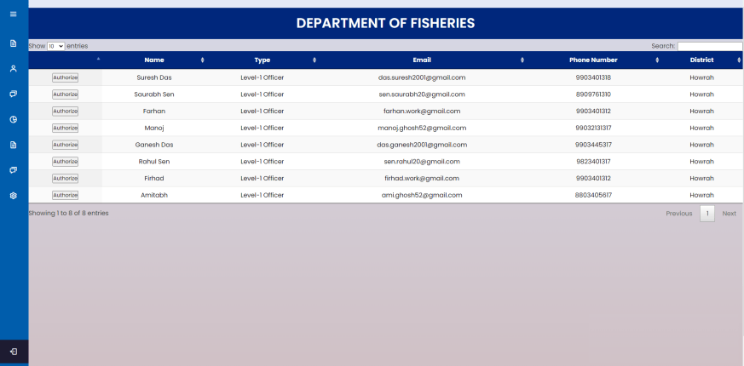
Employee Authorization

Slide 41
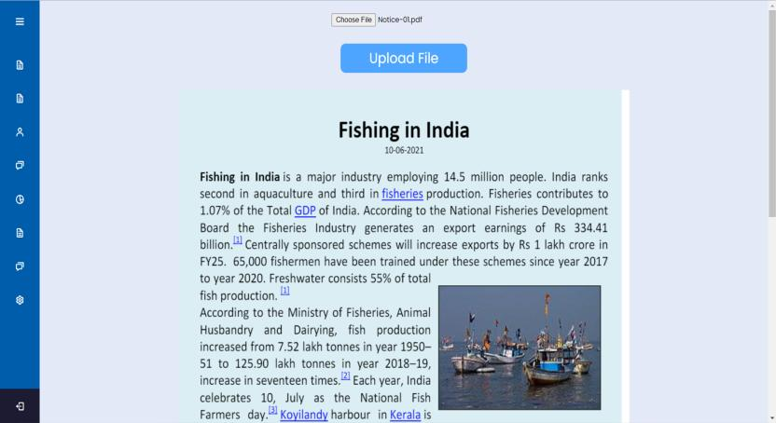
Notice Upload

Slide 42
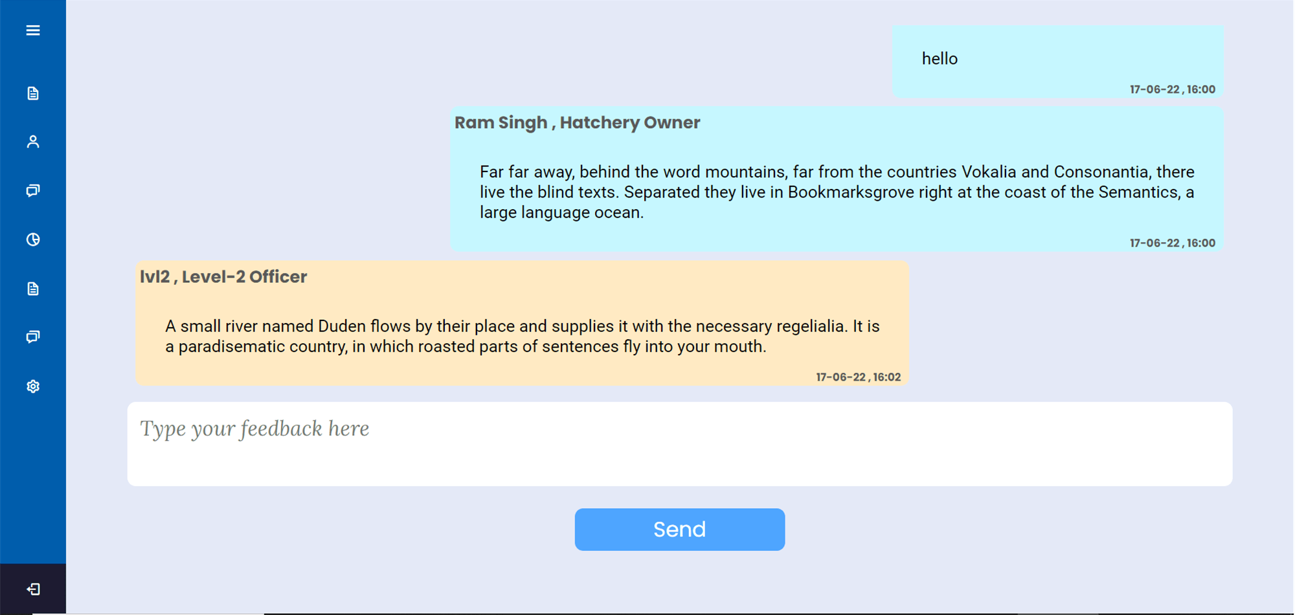
Online Messaging System

Slide 43
DISCUSSION
Limitations of the system :-
As a large number of fishermen or Hatchery Owners come from very poor households, they might find it difficult to get into this system as computers and mobile technologies might be unknown to them. Hence proper training must be provided to the users for a comfortable experience
Internet facilities are still unavailable or very slow in some remote villages where accessing the website and making requests might take a bit too long

Slide 44
DISCUSSION
There are still some places to upgrade this software in a broad level.
Future Scope of The System:
Payment Portal: An online Payment portal with facilities like net-banking and online-wallet payment options.
Online Backup System: A database system that would keep a backup of all important data as a precaution to unforeseen circumstances.
Report Generation: There are various reports that are used in this field to decide the next course of action in the department. Such an automated system that generates these reports can be implemented.

Slide 45

THANK YOU!!

